Slide 1


Manufacturing Analysis & Insights
Prepared by:
Sanuja, Ayush, Rajan, Yashaswini, Shivprasad

Slide 2

Introduction / Objective
Manufacturing analysis as the process of collecting and analyzing data from manufacturing operations to identify areas for improvement.
Increased efficiency and reduced waste.
Improved product quality and consistency.

Slide 3




Tools & Approach
• Excel – Data cleaning, pivot tables, utilization %
• Power BI – Interactive dashboards, weekly trends
• Tableau – Advanced visualizations, storytelling
• SQL – Data extraction, queries
This Photo by Unknown Author is licensed under CC BY-SA

Slide 4
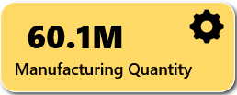
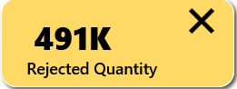
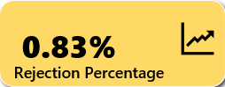
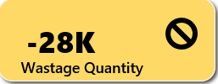
Key KPIs (Manufacturing Performance)
Manufacturing Quantity (60.1M)
Meaning: Total quantity of items produced during the selected period.
Insight: Indicates the overall production output — higher values mean greater manufacturing efficiency and capacity utilization.
Rejected Quantity (491K)
Meaning: Total number of manufactured units that failed quality checks or were rejected.
Insight: Reflects quality issues or production inefficiencies. A high rejection count suggests process defects or poor material quality.
Rejection Percentage (0.83%)
A low percentage (like 0.83%) indicates good quality control.
Wastage Quantity (-28K)
Measures resource efficiency. Lower wastage reflects better utilization of materials and cost savings.

Slide 5
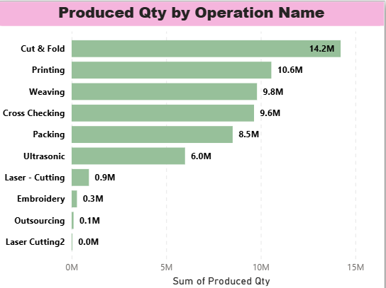
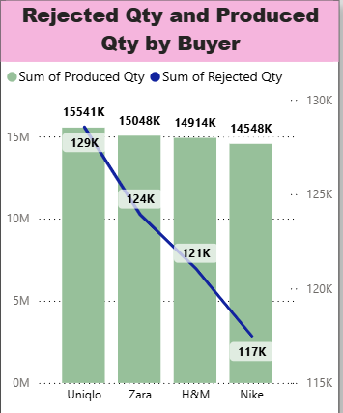
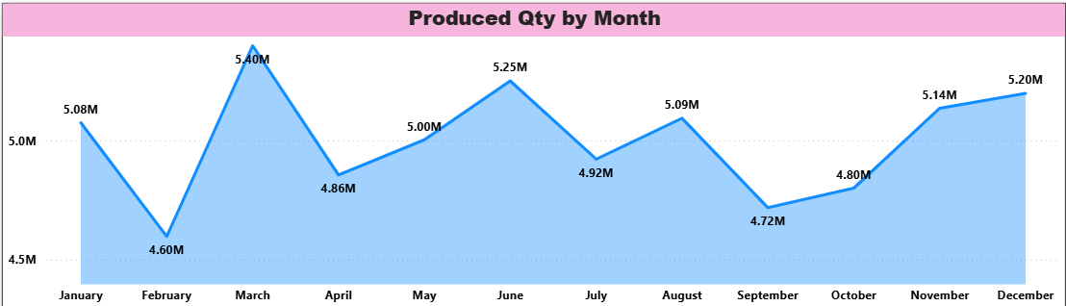
Charts(Manufacturing Performance)

Slide 6
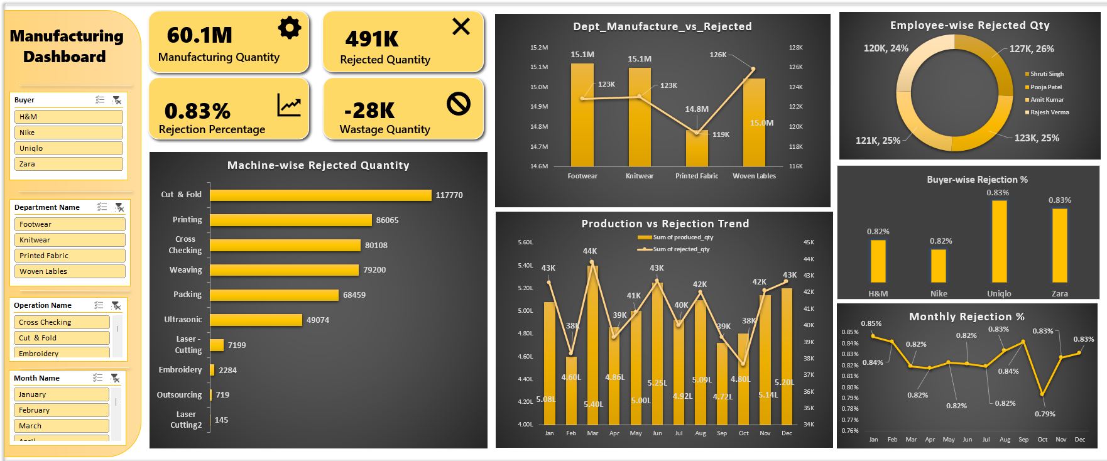
Excel Dashboard

Slide 7
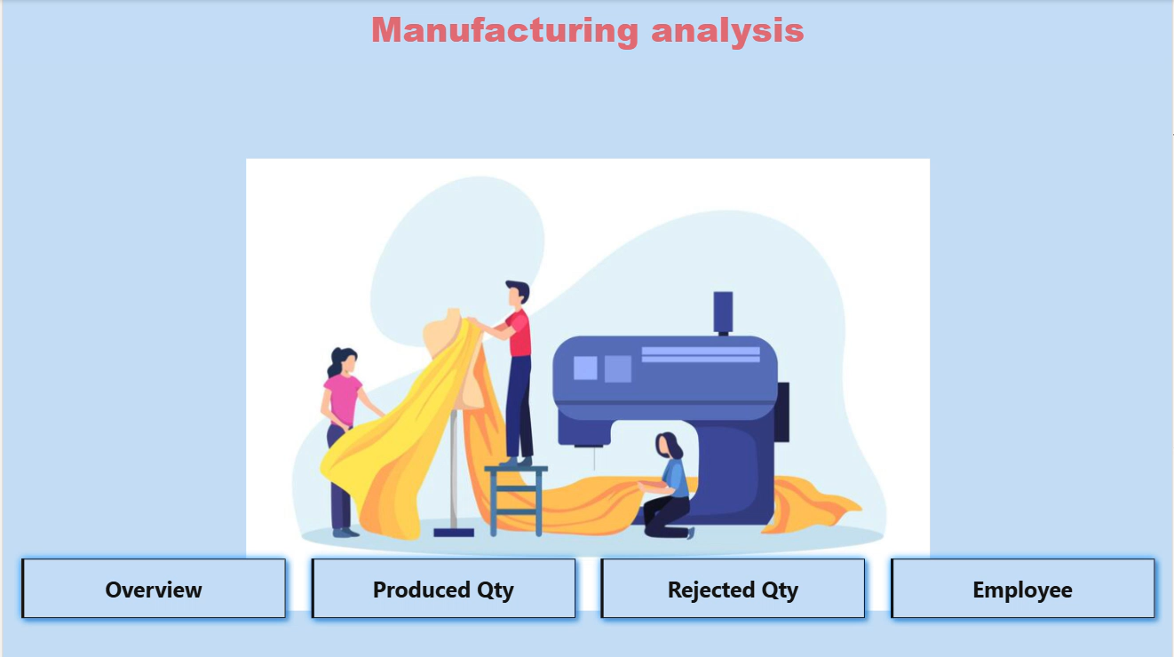
Power BI Dashboard

Slide 8
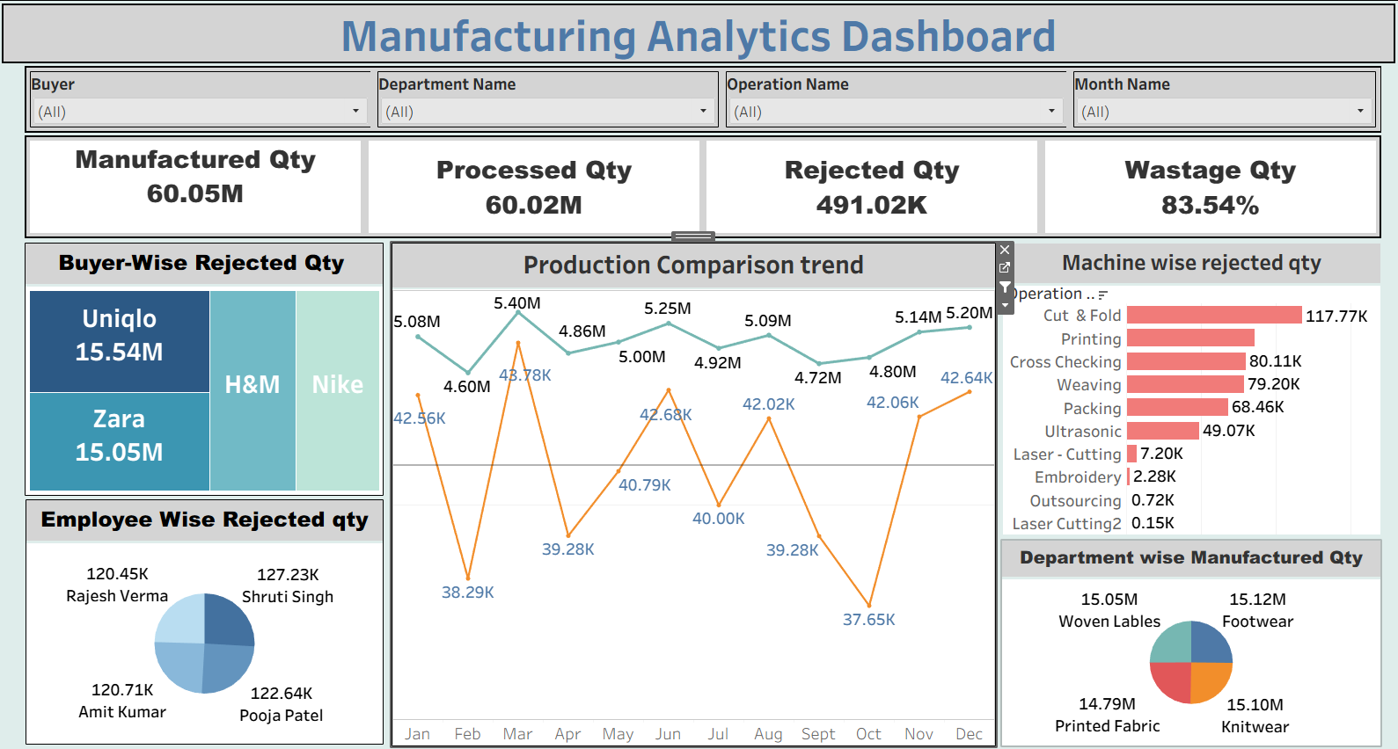
Tableau Dashboard

Slide 9
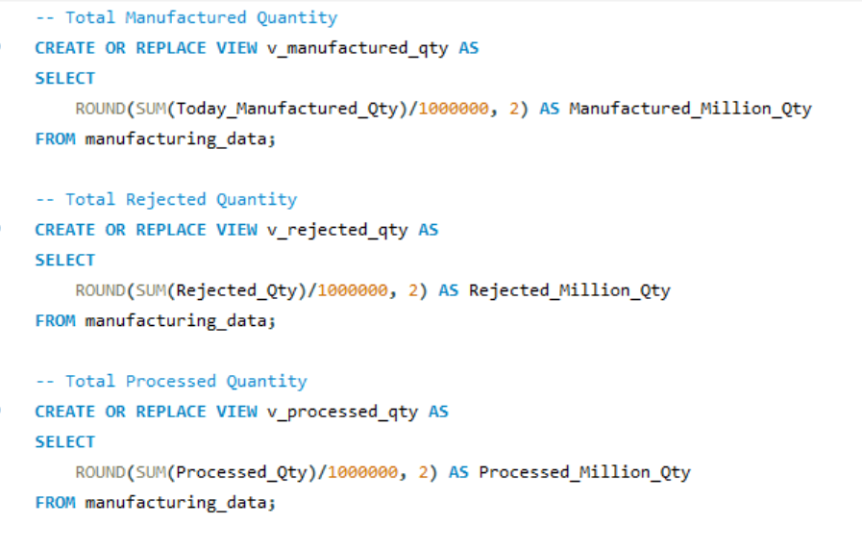
SQL Queries…

Slide 10
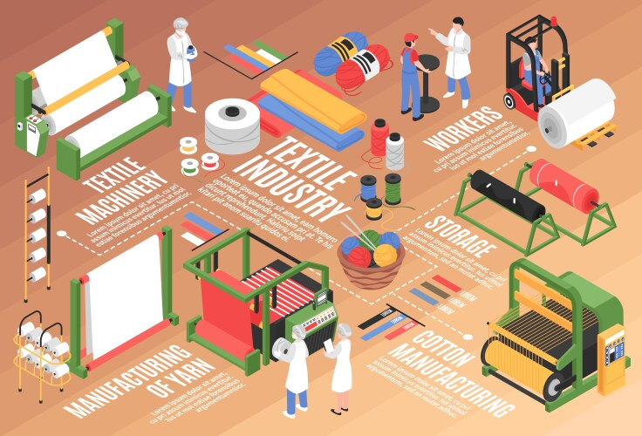
Comparative Insights Across Tools
• Excel – Quick calculations and simple reporting
• Power BI – Strong interactivity and connectivity
• Tableau – Advanced visualization and storytelling
• SQL – Reliable backend querying
→ Using multiple tools strengthened the overall analysis

Slide 11

Key Findings
• Rejected Quantity 491K (Can be Controlled).
• Late Delivery of Produced Quantity Rate 20M should be decreased.
• Some operations such as Laser cutting, Outsourcing, etc should work on there Produced Qty.

Slide 12
Conclusion & Recommendations
• Evaluate quality levels through rejection analysis.
• Should Optimize process efficiency and delivery timelines.
•Track production performance month by month.

Slide 13
THANK YOU

